Slide 1

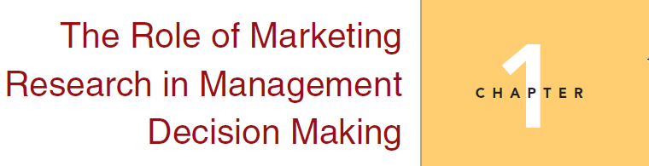
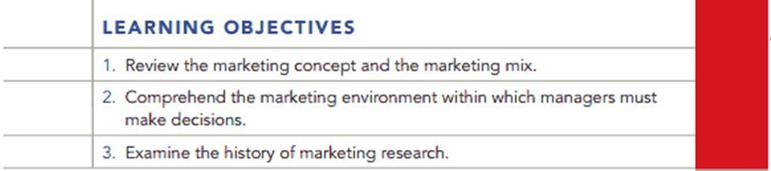
Chapter 1
1-1

Slide 2
Why Study Marketing Research?
Some students eventually become marketing researchers
Everyone needs to be a smarter consumer of marketing research
Every manager needs to understand what marketing research can and cannot do.
Notes:
As a consumer, you are exposed to many resarch restulst. You need to determine whether these reuslts are valid.

Slide 3
Comment on the following statement
The owner of a restaurant in a downtown : “I see customers every day whom I know on a first-name basis. I understand their likes and dislikes. If I put something on the menu and it doesn’t sell, I know that they didn’t like it. I also read the magazine Modern Restaurants, to keep up with industry trends. This is all of the marketing research that I need to do.”
Notes:
An item on the menu may not sell because the customers are not familiar with it. Or, it may be perceived as too expensive. There could be many reasons why a product might not sell as well as the owner wants it to
While a national magazine can determine national trends in the restaurant business, these trends are not always completely applicable at the local level. Marketing research could help the owner become familiar with the favorite foods in the local geographic market.

Slide 4
Who Does Marketing Research?
Producers of Products and Services
    e.g., Goodyear, Silver Dollar City ;
  Advertising Agencies
    e.g., Dentsu, McCann-Erickson WorldGroup
Marketing Research Companies
        e.g., The Nielsen Company, Arbitron;
Notes:
The three major categoris of firms that conduct marketing research are
Coke latte, they need to find out whether consumers like the taste and how the taste would be like.
Dentsu, which controls around 30% of Japan’s advertising.
The World Cup example provided is an excellent means to discuss how an agency works behind the scenes to determine the positioning of a single product to two different market segments. Identify the world cup is much less commercial than super bow. World cup ads should target more on younger Hispanic consumers.
A few years, the Mccann-erickson worldgrop conducted a research on attitudes about soccer. They collect data from men and woman in 39 countries around the world. U.S. respondents believed that the world cup is less commercial than U.S. special events such as super bowl. The group best be able to correctly identify world cup sponsors included young Hispanic consumers. These are important information for firms that would like to do the advertising campaigns.

Slide 5
Who Does Marketing Research?
What differences might you note among marketing research conducted for (a) a retailer, (b) a consumer goods manufacturer, (c) a charitable organization?
Notes:
A retailer might use marketing research to track trends in demographics, to determine effective advertising strategies, and to find products or services desired by the customer.
A consumer goods manufacturer might use marketing research to help determine the probability of success of a new product or to keep current on its competitors’ activities and success. It might also use it to ascertain the best target market for current products.
A charitable organization might use marketing research to determine what services are most needed in a demographic target market and to find the most effective vehicle for delivering those services. It might also use marketing research to identify potential donors and to find the most effective way to appeal to them.
Charitable organization: American heart association.
Raise fund through public service. Selling publicaions or products, selling tickets to events.
Fundraiing event, lauchn a social media competition.

Slide 6

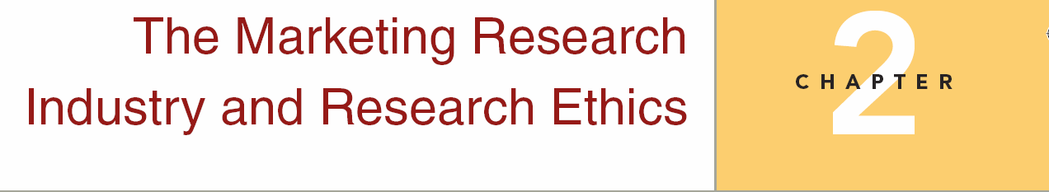
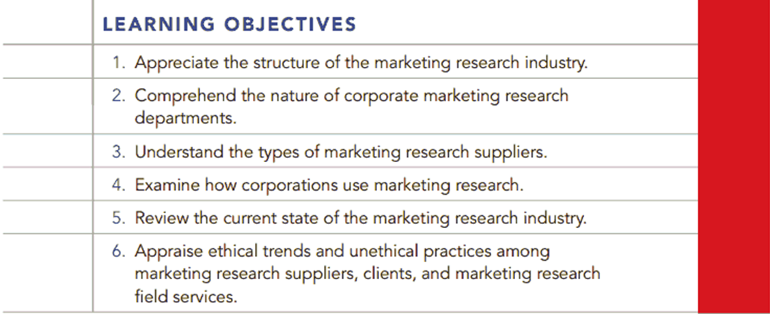
Chapter Two
2-1

Slide 7
The Concept of Total Error
Poorly Written
Research Report
Poor Problem
Formulation
Poor Logic
TOTAL
ERROR
Improper Use of
Statistical Procedures
Selection of
Improper Research
Design
Inadequate
Sample Size
Poor Data
Collection Methods
Inadequate
Sample Design
Notes:
It is critical for present and future managers to know that research is not perfect. Emphasize the key error in research‑‑total error. It is helpful here to point out that sampling error is one part of total error and that increasing sample size to reduce sampling error might actually increase total error. This helps to allay somewhat the tendency demonstrated by beginning researchers to argue that the key to most research problems is to increase sample size.
This slide is particularly useful in getting students to understand why it is important to take this course.
Students planning some type of marketing management career need to learn how to evaluate proposed and/or completed research projects in each of these areas. Failure to recognize how findings, conclusions, and recommendations might be the result of error in the research process can have disastrous effects when decisions are based poorly implemented research.
Students planning a career in marketing research obviously need to learn how to avoid or minimize these sources of error in order to provide clients with information that is truly actionable.

Slide 8
Ethics
Marketing ethics
  The principles, values, and standards of conduct followed by marketers
Ethical considerations are applicable to
  Research participants
  Research clients
  Research teams

Slide 9
Questionable Ethical Decision Making
Forrester Research Inc. published their comparison studies.
  Microsoft and PeopleSoft was favored over their respective competitors.

Slide 10
Questionable Ethical Decision Making
Forrester Research Inc. published their comparison studies.
  Microsoft and PeopleSoft was favored over their respective competitors.
Microsoft and PeopleSoft had funded the research.

Slide 11
Approaches to Ethical Reasoning
Utility Approach
  Focuses on society
  Benefit > Cost, Ethical; Benefit < Cost, Unethical
Use video cameras to record consumer’s behaviors in the store to decide how to display nutritional content.
Notes:
To a utilitarian, the choice that yields the greatest benefit to the most people is the choice that is ethically correct.

Slide 12
Approaches to Ethical Reasoning
Use video cameras to record consumer’s behaviors in the store to decide how to display nutritional content.
  Benefits: knowing how consumers really behave so that companies can develop better ways of communicating the information.
  Costs: violation of shoppers’ privacy. The cost of doing research.

Slide 13
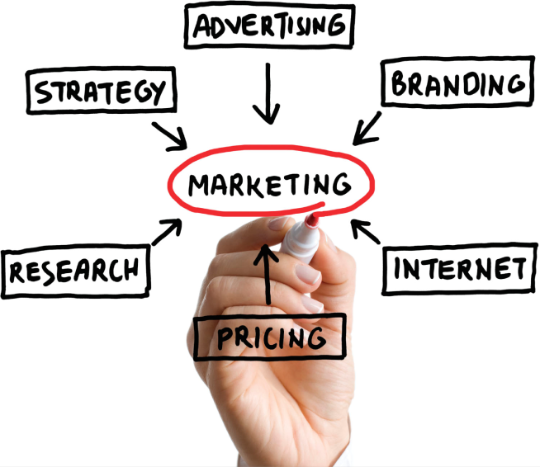
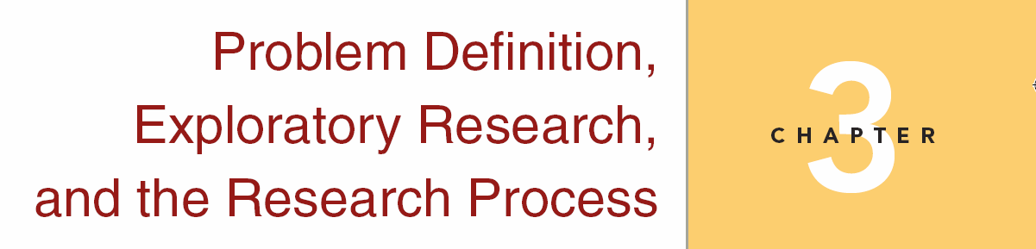
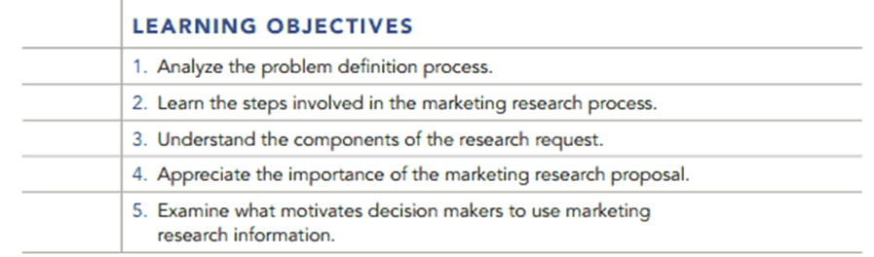
Chapter Three
3-1

Slide 14
Types of Research Design
Exploratory Research
  Major emphasis: gaining ideas and insights
Descriptive Research
  Major emphasis: determining the frequency with which something occurs
Causal Research
  Major emphasis: determining cause-and-effect relationships

Slide 15
Relationships Among the
Research Designs
Descriptive
Research
Exploratory
Research
Causal
Research

Slide 16
Case
Manager’s decision problem (broad)
  Revenue is not as high as expected, why?
Research problem (specific)
Copyright 2009 John Wiley & Sons, Inc.

Slide 17
Case
Your friend opened a coffee shop but the business is not running well.
Your friend consulted you since you are a marketing research expert.

Slide 18
Case
Questionnaire:
What kind of questions are you going to put in a survey?
  Current customer satisfaction?
  What kind of products do they prefer?
  What are the demographics of targeted market?

Slide 19
Case
Questionnaire:
What kind of questions are you going to put in a survey?
Many possibilities
  Advertising, store design, competitors, etc.
It is impossible to include everything in a single questionnaire.

Slide 20
Case
You have to visit the coffee shop and ask your friend many questions before you identify the research questions.
  How bad is the store’s financial position?
  What are your prices like?
  What is your target market?
  Where do you place your advertisements?
  What is your store hour?
  How often do you have promotions?

Slide 21
Case
Manager’s decision problem (broad)
  Revenue is not as high as expected, why?
Research problem (specific)
Reasons could be:1) Product limitation, 2) possible pricing problem, 3) target market inappropriate 4) too many competitors
Copyright 2009 John Wiley & Sons, Inc.
Notes:
turnout and revenue outcomes are disappointing

Slide 22
Case
Exploratory research
  Interview customers
  Literature search
  Focus group
Descriptive research
  Survey
  Observational study
Copyright 2009 John Wiley & Sons, Inc.

Slide 23
Exploratory Research
Basic uses
  Better understanding of the situation
  Not designed to come up with final answers and decisions
Key Characteristics
  Small scale
  Flexibility
Notes:
Rarely use detailed questionari or complex sampling plan.
Investigators follow intuition in a explotary study.

Slide 24
Types of Exploratory Research
Literature Search
Depth Interviews
Focus Groups
Case Analyses
Projective Methods
Experience survey
Notes:
Experience survey , not survey, informal discussion, rarely include a formal questionnaire.

Slide 25
Types of Exploratory Research
Literature Search
  A search of statistics, trade journal articles, other articles, magazines, newspapers, and books for data or insight into the problem at hand
Depth Interviews
  Interviews with people knowledgeable about the general subject being investigated
Focus Groups
  An interview conducted among a small number of individuals simultaneously
Notes:
Look for existing data from various sources, such as trade journal articles, magazines, industry reports

Slide 26
Types of Exploratory Research
Case Analysis
  Intensive study of selected examples of the phenomenon of interest
Projective Methods
  Methods that encourage respondents to reveal their own feelings, thoughts, and behaviors by shifting the focus away from the individual through the use of indirect tasks

Slide 27
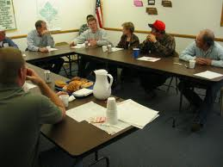
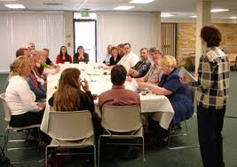

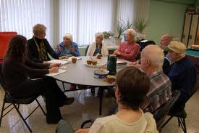
Focus Group

Slide 28
Focus Groups
Extremely popular research technique
Format
  Typically 8-12 people
  Homogeneous within group
  1.5 to 2 hours in length
  Sessions recorded and transcribed
Key person: the moderator
Notes:
Homogenous; 1. social status
2. Household chores, married mem/woman

Slide 29
2a. Descriptive Research Studies
Marketing Research Design, Continued
Descriptive Studies Defined
Descriptive research studies answer the, who what, where, when and how questions. It is used when one wants to gain a better understanding of the specifics or details the research issue.
Confirm Theories
Brand Loyalty Measure
Describes Population
Build Customer Profile
Gain Specific Information
Secondary Data
Cross sectional Surveys
Longitudinal Surveys
Statistical Data Analysis
Purpose
Key Methods
3-11
Key Terms & Definitions

Slide 30
Descriptive Research
Has six specifications:
  Who
  What
  When
  Where
  Why
  How
Surveys and Observations
Notes:
Exploratory research is very flexible; descriptive research is much more rigid

Slide 31
A descriptive research design
Super Savers is a chain of department stores located in large towns and metropolitan centers in the northeastern United States.
In order to improve its understanding of the market, management has decided to develop a profile of the “average” customer (customer segments). You are requested to design the study.
Notes:
What are possible variables that you can classify them?
age of respondents, sex of respondents, income, educational level, household size, residence, or location.

Slide 32
A descriptive research design
 | Store Preference by Income
Income | Prefer Super Savers | Prefer Competitors
>$100,000
$50,000~$100,000
$<50,000
Notes:
Younger shoppers frequent our stores more than older shoppers, low income customers frequent our stores more than middle‑ or high‑income customers, and larger households shop at our stores more than smaller households.

Slide 33
A descriptive research design
 | Store Preference by Education
Education Level | Prefer Super Savers | Prefer Competitors
Some high school
High school
Some college
….
Churchill Brown Suter/Basic Marketing Research

Slide 34
Causal Research
The purpose of causal research is to test cause and effect relationships
Condition X causes Event Y
(e.g., X Y)

Slide 35
Causal Research
Evidence of Causality
  Time Order
    Evidence that shows X occurs before Y
  Consistent variation
    Evidence of the extent to which X and Y occur together or vary together in the way predicted by the hypothesis
  Elimination of Other Explanations
    Evidence that allows the elimination of factors other than X as the cause of Y
Notes:
Before a cause and effect relationship can be inferred, the following types of evidence must be present.
Consistent variation—think it as a type of correlation.
just because two variables are highly correlated with one another does not mean that one of the variables causes the other to occur. There may be other factors that actually cause all of these outcomes to occur.
Time order—evidence that shows independent variable - X occurs before dependent variable – Y
e.g., a restaurant manger blame a decrease in sales over a new chef if the drop in sales occurred beofre the new chef arrived. Adversting must appear before the change in sales.
When two variables are highly correlated, and one of them precedes the other, there is greater reason to believe the antecedent variable might be the cause of the subsequent variable. However, this still is not sufficient evidence.
Elimination of other explanations—evidence that allows the elimination of factors other than independent variable - X as the cause of changes in dependent variable - Y
Because we can never know for certain that we have eliminated all other possible causes of an effect, we can never state with certainty that independent variable - X caused changes in dependent variable - Y. Nevertheless, the stronger the evidence is in each of these areas, the more confident we can be in making a cause-effect inference.
Because predictive Descriptive studies only look at one of the three types of evidence, they are incapable of making causal inferences.
Problem 5 test exam

Slide 36
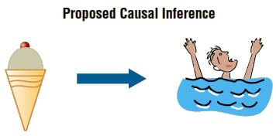
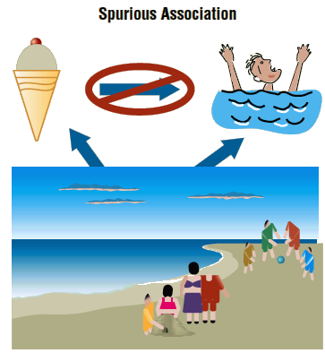
The Spurious Effect of Ice Cream
Notes:
When more are sold, more people drown. Ban ice cream?
When the beach is paricularly crowded, more ice cream is sold and more people drown.

Slide 37
Evidence of Causality
Because we can never know for certain that we have eliminated all other possible causes of an effect, we can never state with certainty that X caused Y.

Slide 38
Spurious Relationship
Shoe size and reading performance for elementary school children.
Number of police officers and number of crimes.
Number of doctors in region and number of people dying from disease.
Tea drinking and lung cancer
Notes:
Age: Older children have larger shoe sizes and read
better.
Tea drinkers have a lower risk only because
they smoke less

Slide 39
Causal Research
Causation is often tested through experimentation
Experimentation includes independent (condition X) and dependent (event Y) variables
The basic point of an experiment is to change the levels of one or more X variables and examine the resulting impact on Y variables
At the same time, it is very important to control (i.e., hold constant) other variables that might impact Y variables

Slide 40
Relationships Among the
Research Designs
Descriptive
Research
Exploratory
Research
Causal
Research
Notes:
Continous process. Exploratory is the first step. Most projects involdue some degree of exploratory and descriptive. Only some needs causal research. The design mostly depends on how much the managers already know the issues.
Coca uses descriptive research. No causal research.

Slide 41
Relationships Among the Research Designs
Manager’s decision problem (broad)
  Brand X’s share of the soft drink market is slipping. Why?
Research problem (specific)
  Identify the reasons
Notes:
This statement is too broad to serve as a guide for another two research. explore to narrow and refine the problem.
Explora should be used to narrow and refine the problem. The goal is to find possible explanations for the sales decrease. These tentative explanations or hypotheses, would then serve as specific guids for descriptive or causal studies. Suppose you find that brand x’s is an economy prirced soft drink.

Slide 42
Symptoms of problems and underlying real problems
Symptoms: Declining sales
Reasons:1) poor positioning strategy, 2) possible pricing problem, 3) a promotional strategy error, or 4) a product / service that is not competitive.

Slide 43
Case Discussion
Decision problem
  “Should enter this market?”
  “How should the business be organized?”

Slide 44
Case Discussion
  Research problems:
  determine awareness of online grocery shopping among target market
  assess satisfaction of existing online grocery shoppers
  determine existing levels of online shopping in target market
  investigate target market preferences for products to be purchased online
  determine level of demand for online grocery shopping among target market

Slide 45
Census vs. Sample
If your target market is new homeowners in a small city in any given month, a census would be better.
If your target market is parents of babies born in December in a particular county, a census might be better.
Notes:
Census means the whole population

Slide 46
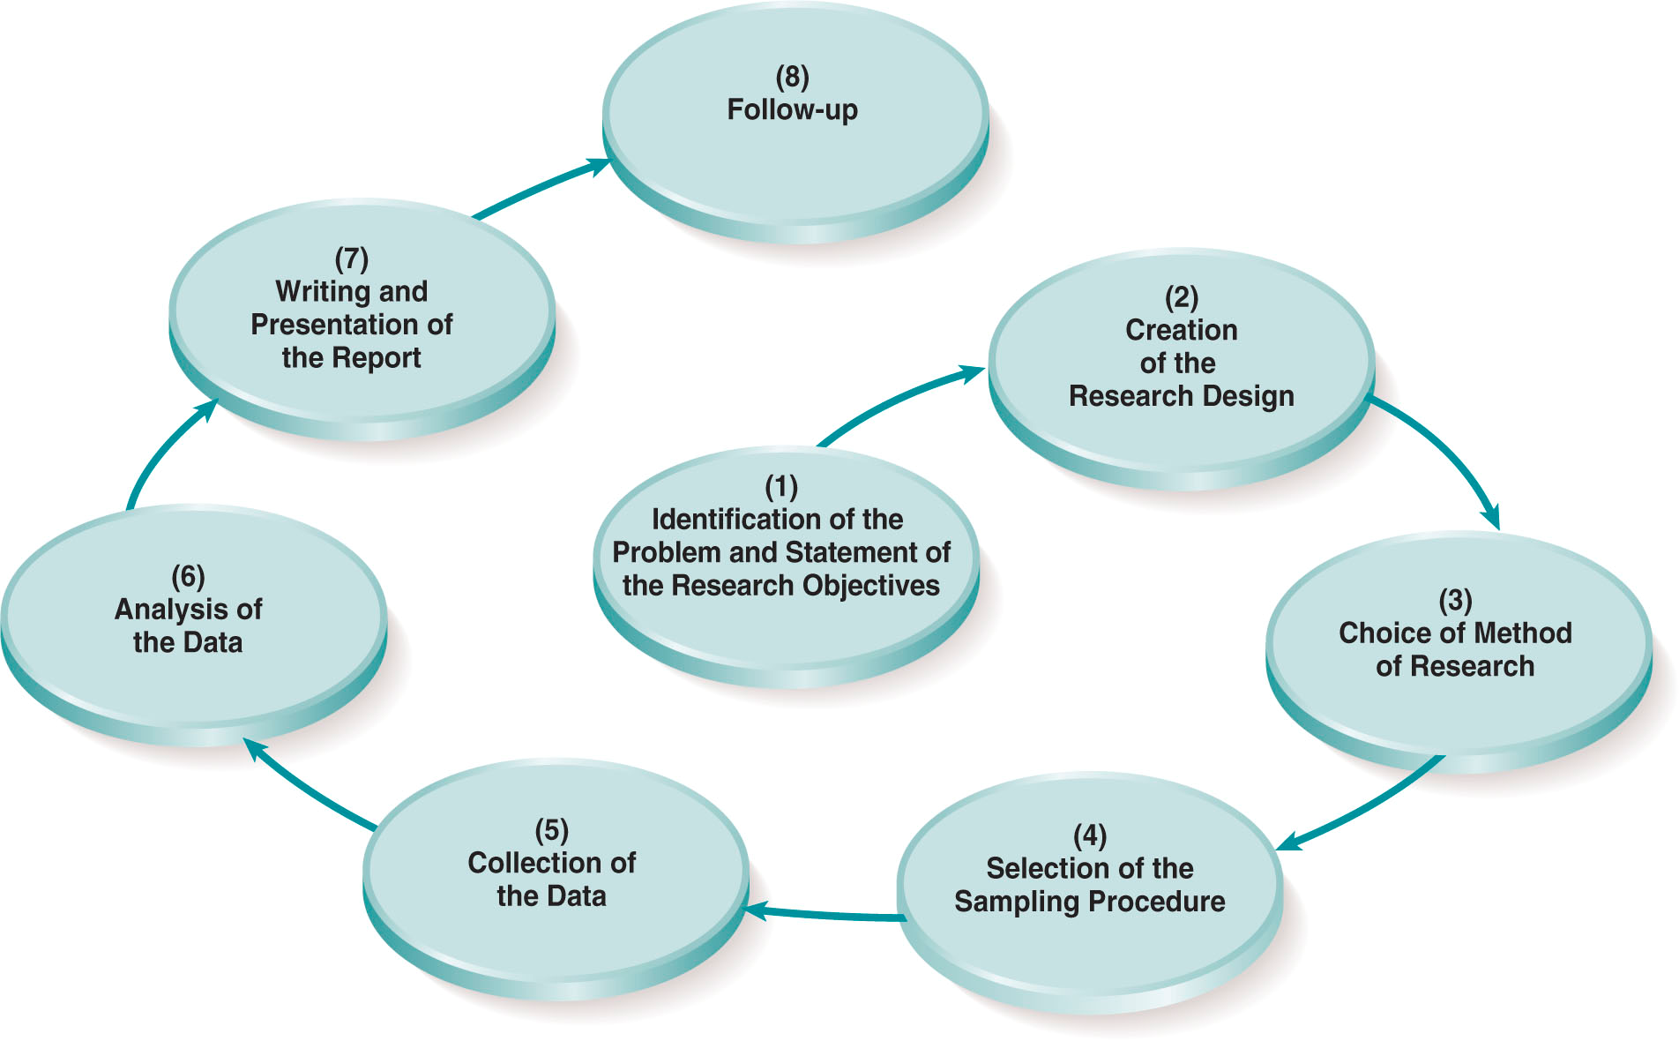
The Marketing Research Process
An Overview
3-6

Slide 47
Steps to do marketing research
You have been charged with determining how to attract more business majors to your school. Outline the steps you would take, including the sampling procedures to accomplish this task.

Slide 48
Steps
Identify the problem and state the marketing research objectives.
Create the Research Design.
Choose the Basic Method of Research.
Selection of the Sampling Procedure.
Collecting the Data.
Analysis of the Data.
Preparation and Writing the Report.
Follow up.
Notes:
The problem is that there are not enough Business majors. The research objective is to find out why students are not enrolling and what can be done to encourage more students to enroll in the College of Business.
Research Design: Case studies, descriptive, studies, or causal studies might be used. In this case a descriptive study seems to be indicated.
Method of research: Surveys, observation, or experiments. In this case a survey could give good results.
If you ask the right people the correct questions, surveys can obtain specific answers to the research questions. Almost certainly the research will be done in the form of a survey of the target market to measure attitudes and perceptions concerning the College of Business.
In the College of Business question, there are probably at least four relevant segments in the population of interest; current students, students in high school whom we could be recruiting, transfer students, and non-traditional students.
We might hire a field service firm to administer the survey or train a research team composed of in-house resources.
Non-traditional student
Do not immediately continue your education after you graduate from high school
Attend college only part time
Work full time (35 hours or more per week)
Are financially independent
Have children or dependents other than your spouse
Are a single parent
Have a GED, not a high school diploma

